Slide 1
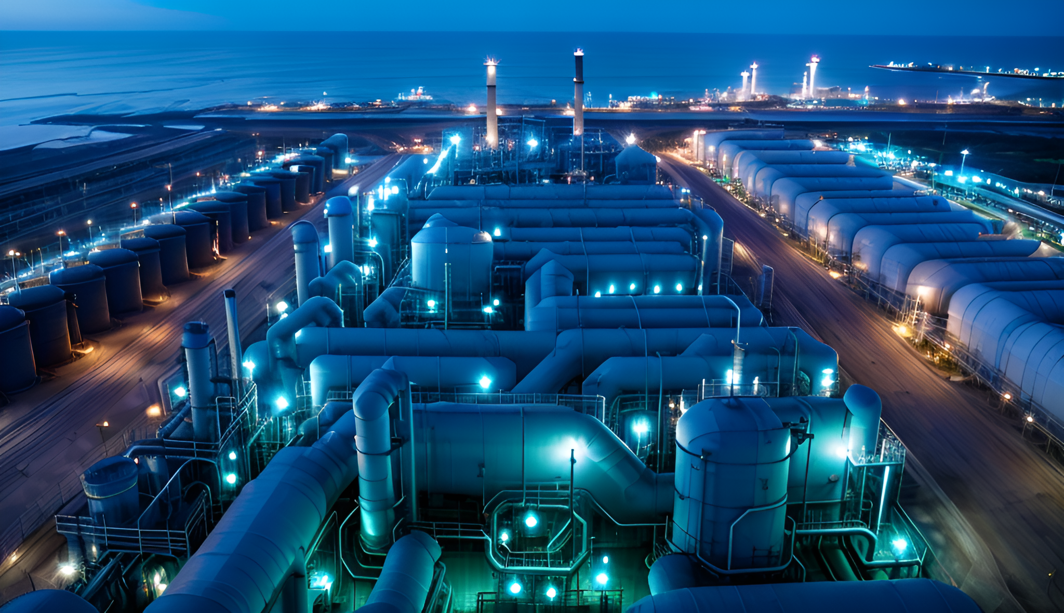
In the rapidly evolving world of contract manufacturing, staying ahead of industry trends is crucial for maintaining a competitive edge. As we look towards 2024, several key trends are set to shape the future of contract manufacturing. From the integration of advanced technologies like AI and robotics to advancements in supply chain management and the growing demand for customizable solutions, these trends are transforming the landscape of manufacturing. In this post, we explore these upcoming trends and their potential impact on the industry.
What’s Next in Contract Manufacturing? Key Trends to Watch in 2024

Slide 2



What’s Next in Contract Manufacturing? Key Trends to Watch in 2024
In the rapidly evolving world of contract manufacturing, staying ahead of industry trends is crucial for maintaining a competitive edge. As we look towards 2024, several key trends are set to shape the future of contract manufacturing. From the integration of advanced technologies like AI and robotics to advancements in supply chain management and the growing demand for customizable solutions, these trends are transforming the landscape of manufacturing. In this post, we explore these upcoming trends and their potential impact on the industry.

Slide 3
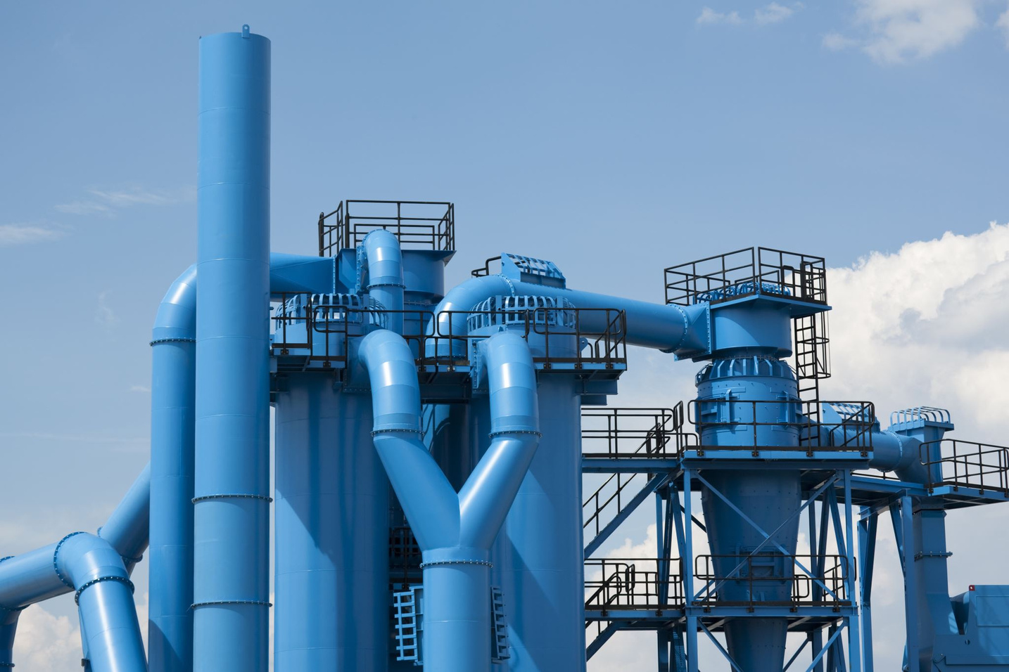
The Importance of Energy Efficiency in Plastic Manufacturing
Energy efficiency is pivotal in reducing the environmental impact of plastic manufacturing. By optimizing energy use, manufacturers can decrease greenhouse gas emissions, lower operational costs, and create a more sustainable production cycle. This aligns with global efforts to combat climate change and promotes a greener future for the industry.

Slide 4
Advanced Injection Molding Machines
Modern injection molding machines are designed to be more energy-efficient. These machines utilize servo motors and advanced control systems to optimize energy consumption during the molding process. By reducing energy use without compromising on performance, manufacturers can achieve significant savings and a lower carbon footprint.
Example: At Flair-Plastic, our new generation of injection molding machines has led to a 30% reduction in energy consumption. These machines are not only more efficient but also provide higher precision, resulting in less material waste and higher-quality products.
Innovative Technologies Driving Energy Efficiency
Energy-Efficient Lighting and HVAC Systems
Upgrading to energy-efficient lighting and heating, ventilation, and air conditioning (HVAC) systems can significantly reduce energy consumption. LED lighting and advanced HVAC systems are not only more efficient but also offer better performance and longer lifespans.
Example: By replacing traditional lighting with LED systems and upgrading our HVAC units, Flair-Plastic has achieved a 25% reduction in energy consumption for lighting and climate control, creating a more comfortable and sustainable working environment.

Slide 5

Case Study: Flair-Plastic's Commitment to Energy Efficiency
At Flair-Plastic, our commitment to sustainability is evident in every aspect of our operations. Here are some of the key initiatives we've implemented to enhance energy efficiency:
Optimized Machinery: Our investment in the latest injection molding machines has resulted in a 30% reduction in energy consumption while maintaining high-quality production standards. These machines are designed to minimize energy use during each phase of the production process.
Smart Energy Management: Utilizing advanced analytics, we continuously monitor and optimize our energy use, ensuring we always operate at peak efficiency. This proactive approach allows us to quickly identify and address any inefficiencies.
Employee Training: Our workforce is trained on energy-efficient practices, ensuring that every team member contributes to our sustainability goals. Regular training sessions and updates keep our staff informed about the latest energy-saving techniques and technologies.

Slide 6


The Benefits of Energy Efficiency
The benefits of implementing energy-efficient practices in plastic manufacturing extend beyond environmental impact:
Cost Savings: Reduced energy consumption leads to lower operational costs, translating into significant financial savings over time. These savings can be reinvested into further innovations and improvements.
Enhanced Reputation: Companies that prioritize sustainability are viewed more favourably by consumers, stakeholders, and investors. This positive perception can lead to increased brand loyalty and market share.
Regulatory Compliance: Adhering to energy efficiency standards helps ensure compliance with environmental regulations, avoiding potential fines and enhancing corporate responsibility. This proactive approach also positions Flair-Plastic as a leader in sustainable manufacturing practices.

Slide 7

Energy efficiency is not just a trend but a necessity in the modern plastic manufacturing industry. At Flair-Plastic, we are dedicated to leading the charge towards a sustainable future, employing innovative technologies and practices that reduce our carbon footprint while delivering superior products to our customers. Our commitment to energy efficiency not only supports environmental sustainability but also drives our growth and success in a competitive market. Join us on our journey towards a greener, more efficient world.
Takeaway

Slide 8

Stay posted with Flair-Plastic's latest green initiatives and innovations by subscribing to our newsletter. Follow us on social media for more insights and updates on our commitment to sustainability.

